Slide 1

Software Development Life Cycle (SDLC)
Definition: Software Development Life Cycle (SDLC) is a framework that defines the steps involved in the development of software at each phase. It covers the detailed plan for building, deploying and maintaining the software.
Purpose: Purpose of SDLC is to deliver a high-quality product which is as per the customer’s requirement.
SDLC phases:
Requirement gathering and analysis
Design
Implementation or coding
Testing
Deployment
Maintenance

Slide 2
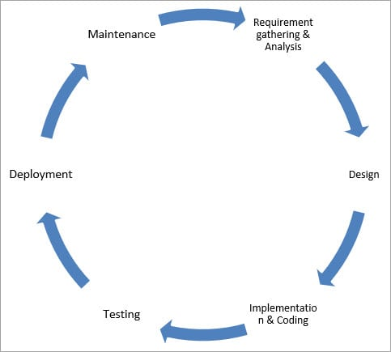
SDLC Cycle

Slide 3
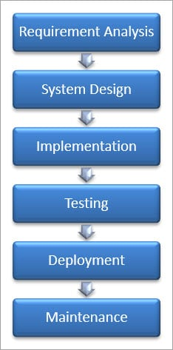
SDLC Models
Definition: A software life cycle model is a descriptive representation of the software development cycle. SDLC models might have a different approach but the basic phases and activity remain the same for all the models.
Waterfall Model

Slide 4

Advantages and Disadvantages of Waterfall
Advantages of the Waterfall Model:
Waterfall model is the simple model which can be easily understood and is the one in which all the phases are done step by step.
Deliverables of each phase are well defined, and this leads to no complexity and makes the project easily manageable.
Disadvantages of Waterfall model:
Waterfall model is time-consuming & cannot be used in the short duration projects as in this model a new phase cannot be started until the ongoing phase is completed.
Waterfall model cannot be used for the projects which have uncertain requirement or wherein the requirement keeps on changing as this model expects the requirement to be clear in the requirement gathering and analysis phase itself and any change in the later stages would lead to cost higher as the changes would be required in all the phases

Slide 5


V-Shaped Model
Definition: V- Model is also known as Verification and Validation Model. In this model Verification & Validation goes hand in hand i.e. development and testing go parallel. V model and waterfall model are the same except that the test planning and testing start at an early stage in V-Model.

Slide 6
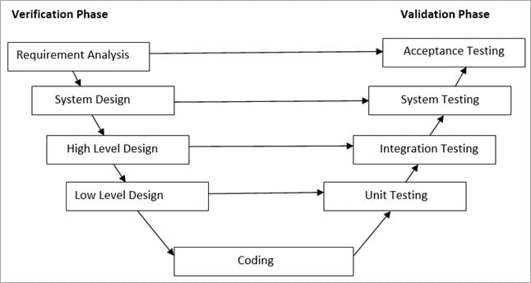
Verification Phase

Slide 7
Advantages and Disadvantages
Advantages of V – Model:
It is a simple and easily understandable model.
V –model approach is good for smaller projects wherein the requirement is defined, and it freezes in the early stage.
It is a systematic and disciplined model which results in a high-quality product.
Disadvantages of V-Model:
V-shaped model is not good for ongoing projects.
Requirement change at the later stage would cost too high.

Slide 8
Agile Model
Agile Model is a combination of the Iterative and incremental model. This model focuses more on flexibility while developing a product rather than on the requirement.
In Agile, a product is broken into small incremental builds. It is not developed as a complete product in one go. Each build increments in terms of features. The next build is built on previous functionality.
In agile iterations are termed as sprints. Each sprint lasts for2-4 weeks. At the end of each sprint, the product owner verifies the product and after his approval, it is delivered to the customer.

Slide 9
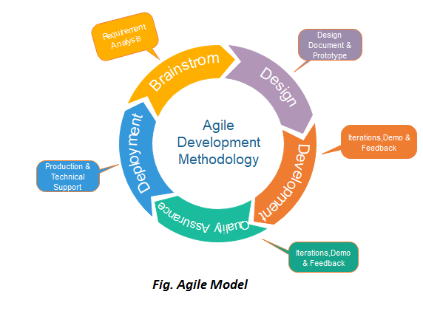
Agile diagram

Slide 10
Agile Testing Methods
Scrum
Crystal
Dynamic Software Development Method (DSDM)
Feature Driven Development (FDD)
Lean Software Development
Extreme Programming (XP)

Slide 11
Scrum method
There are three roles in it, and their responsibilities are:
Scrum Master: The scrum can set up the master team, arrange the meeting and remove obstacles for the process
Product owner: The product owner makes the product backlog, prioritizes the delay and is responsible for the distribution of functionality on each repetition.
Scrum Team: The team manages its work and organizes the work to complete the sprint or cycle.

Slide 12
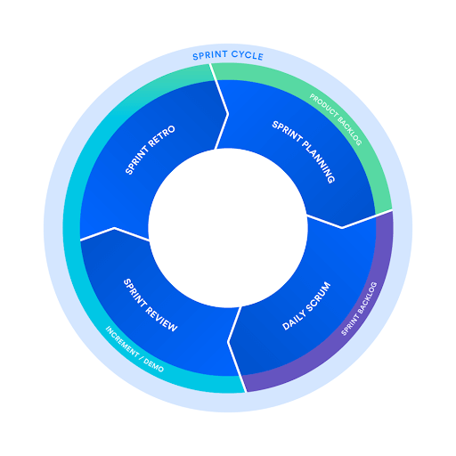
Sprint Cycle

Slide 13

When to use the Agile Model?
When frequent changes are required.
When a highly qualified and experienced team is available.
When a customer is ready to have a meeting with a software team all the time.
When project size is small.

Slide 14

Pros and Cons
Pros:
Frequent Delivery
Face-to-Face Communication with clients.
Efficient design and fulfils the business requirement.
Anytime changes are acceptable.
It reduces total development time.
Cons:
Due to the shortage of formal documents, it creates confusion and crucial decisions taken throughout various phases can be misinterpreted at any time by different team members.
Due to the lack of proper documentation, once the project completes and the developers allotted to another project, maintenance of the finished project can become a difficulty.

